Slide 1




Napro Industries Ltd - Switch Media Partnership Proposal

Slide 2

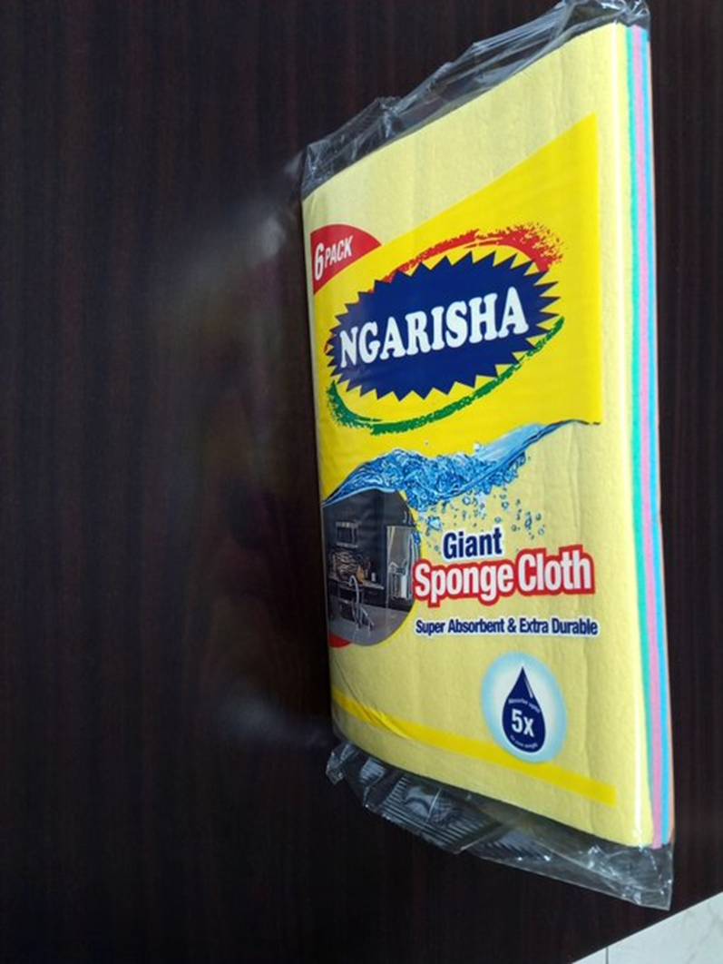
Highlights:
About the Show
TheHost andBroadcast
The Show'sTreatment
Theclosing segment
Execution your Kitchen products’s Products
Expected ROI
RateCard
Partners
Contact

Slide 3
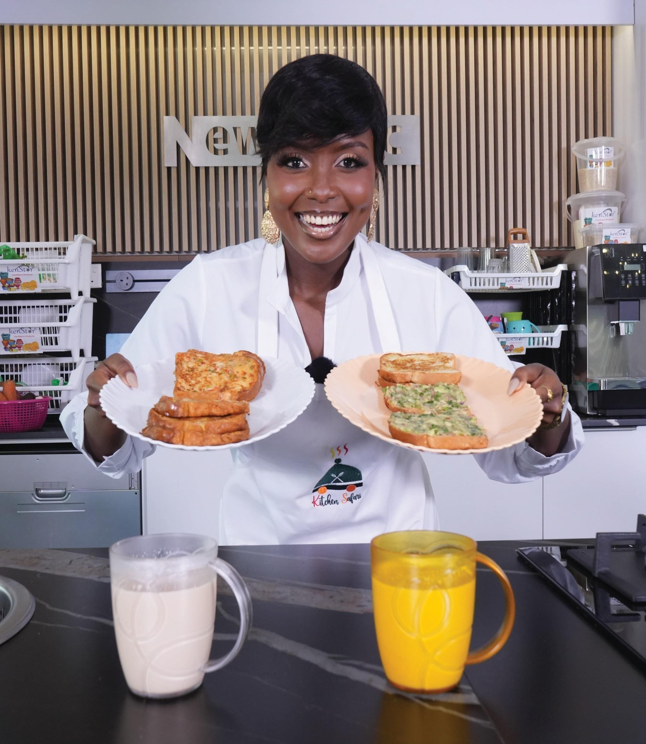
AbouttheShow
"Kitchen Safari" is a lively cooking program that combinesculinary adventurewith cultural flair.
It is produced by Switch Media Limited, a Kenya Red Cross Society Owned Production House, and hosted by KushTracey, who guides viewerson a flavorful journey through traditional andmodernrecipeswith a local twist.
Theshowis broadcastedon Kitchen SafariKe's YouTube channelevery Wednesdayat 6:00 PM while KushTraceypromotes eachepisodeon her socialmedia channelsbefore it is posted.

Slide 4
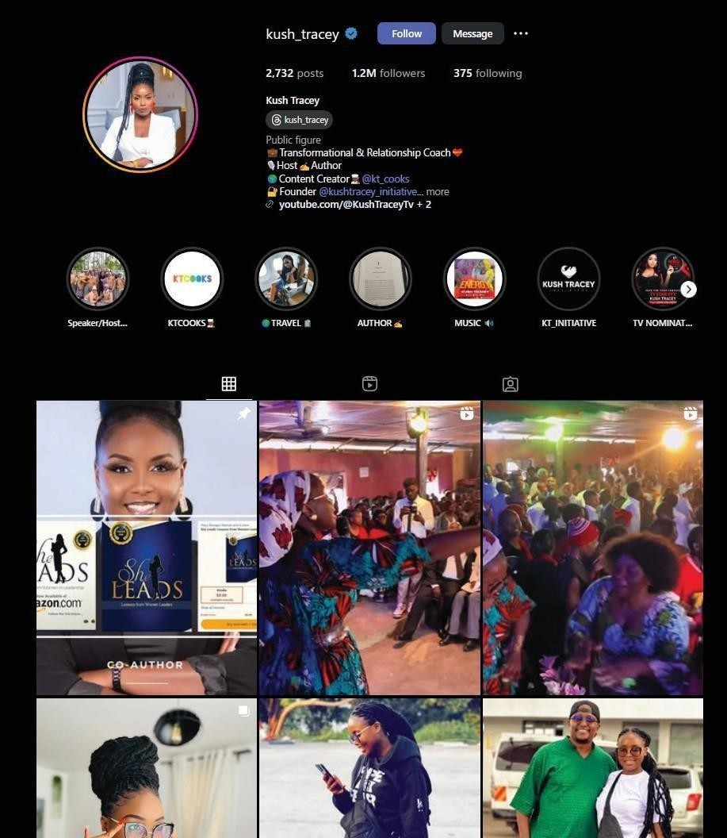
TheHost andBroadcast
Kush Tracey isamedia personalityandTV Host with extensiveexperiencein themedia industry.
She isapassionatecookandfood lover who brings energy and expertise to every"Kitchen Safari" episode.
Shehaslargeand engaged Instagramaudience,making her anideal hostfor the show. Her vibrant personality and relatable content consistentlyattract high levels of interactionfrom herfollowersthroughlikes, comments, and shares.
This strongengagement reflectsher influenceand ability to connectwith a broadanddiverse audience,which will significantly boost the visibility and reach of the show.

Slide 5


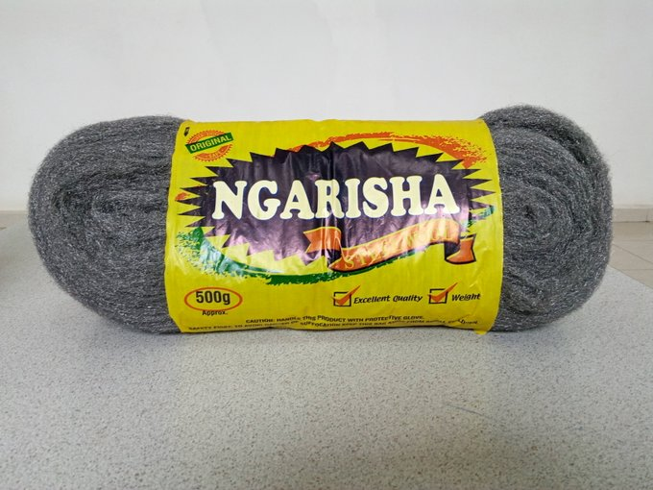
TheClosing Segment
The show concludes with the host and guest cook at the dining table, enjoying the meal prepared during the episode.
This segment alsohighlights the quality of your Kitchen products products meticulously crafted to meet a varietyof needs.

Slide 6
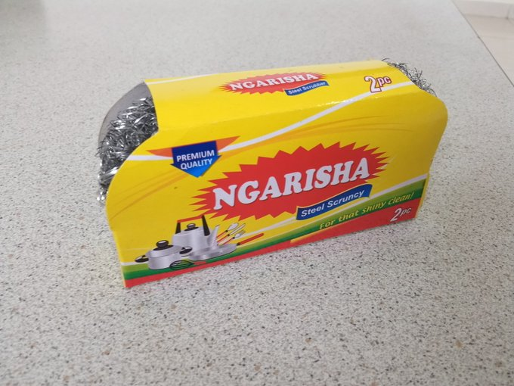
Executionwith your Kitchen Products
The partnership includes:
Host the current marketing head or a brandambassador to discuss the quality and exceptional valueof assorted products.
Have your Kitchen products products featured throughout the cooking season, thisincludesadvertising throughintro and outro boards, squeezebacks, presentermentions,and product placement.
Engagethe audiencewith online trivia questions about your Kitchen products to maintain viewer interest and interaction while (highlighting any availableoffers.)
Incorporating socialmediaposts(Facebook, Instagram,X), aweb banner,and two blogpostsper month.
Promote your Kitchen products assorted productson our host'ssocialplatforms.

Slide 7

ExpectedROI in Each Episode
Increase your Kitchen products sales throughout the cooking show season.
Increase brand perception and awareness of your Kitchen products products in the market.
Make your Kitchen products products preferred over their competitors.
Tailorshowpromotion to the target audience.

Slide 8
KitchenSafariRateCard(Season3 - 13Episodes package
GOLD (Main Sponsor):KSH. 435,000
SILVER:KSH. 300,000
BRONZE: KSH. 200,000
Intro & Outro boards
Presenter Mentions
2 Squeeze-backs
Product placements
Sponsorboardvisibility
Useof assortedproducts
throughout the season
Host a representativeor abrand ambassadorduring the show
SocialMedia Posts(FB, IG,
TikTok,X)
Intro & Outro boards
Presenter Mentions
1Squeeze-backs
Product placements
Sponsorboardvisibility
Useof assorted productsin
6 episodes
SocialMedia Posts(FB, IG, TikTok,X)
Intro & Outro boards
Presenter Mentions
Product placements
Sponsorboardvisibility
Useof assortedproducts in
4 episodes
All ratesaresubject to 16% VAT.

Slide 9










Our Partners

Slide 10

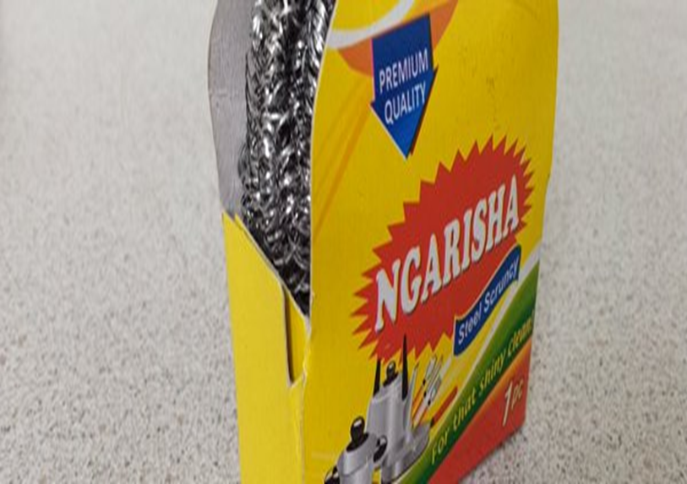

Contact Us:
EMAIL: Wambua.faith@switchmedia.ke
MOBILE: 0714390231

